Slide 1
NETWORK MODELING FOR INFECTIOUS DISEASE SPREAD
Ankith Reddy Tumkunta
Data science
MSDS696 Practicum 1
Regis University

Slide 2
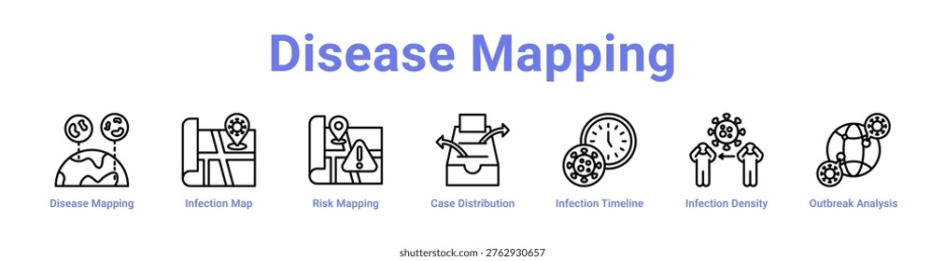
INTRODUCTION
Infectious diseases spread quickly.
Outbreaks create sudden medicine demand.
Disease mapping supports early planning.
Models support manufacturing decisions.

Slide 3

PROBLEM STATEMENT
COVID-19 showed preparedness gaps.
Infectious diseases spread suddenly.
Medicine demand can rise quickly.
Manufacturers need early warning.
Models can improve demand planning.

Slide 4
DATA SOURCES
CDC: weekly disease records.
Census: county population data.
BEA: county income data.
Data covers county-level patterns.
Sources support disease demand prediction.
Source | Used For
CDC-NNDSS | Disease activity
Census | Population
BEA | Income

Slide 5
DATA CLEANING AND MERGING
Started with CDC disease data.
Removed high-missing columns.
Cleaned county and state names.
Prepared population and income data.
Merged CDC, Census, and BEA.
Final dataset: 725,787 rows.
Stage | Rows
CDC raw data | 1,840,440
Merged dataset | 1,079,478
Final clean dataset | 725,787

Slide 6
DATA PREPROCESSING
Used cleaned merged dataset.
Removed zero infection records.
Grouped disease labels.
Selected high-burden diseases.
Final modeling data: 174,042 rows.
Step | Rows
Clean merged dataset | 725,787
Non-zero infection data | 333,028
High-burden disease data | 174,042

Slide 7
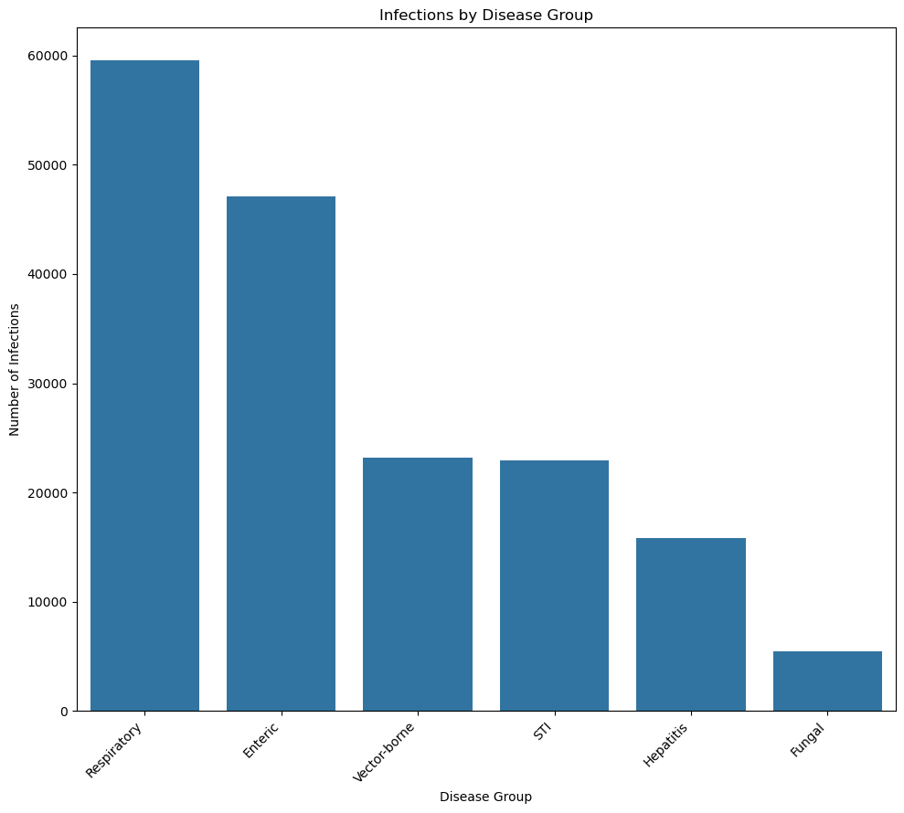
EXPLORATORY DATA ANALYSIS
Infection values were highly skewed.
Most records had low activity.
Few counties showed large outbreaks.
Respiratory diseases appeared most often.
EDA supported log transformation.

Slide 8
FEATURE ENGINEERING
Feature Type | Created Features
Encoded features | State, county, disease type
Lag features | Lag 1, Lag 2, Lag 3, Lag 4
Seasonal features | Week sin, Week cos
Numeric features | Population, income
Encoded disease and location values.
Created lag 1–4 features.
Added week_sin and week_cos.
Scaled population and income.
Prepared data for model training.

Slide 9
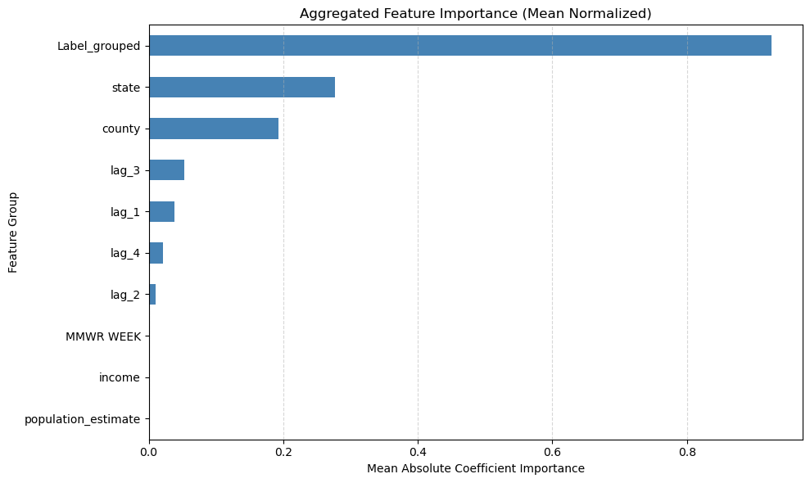
Gaussian Bayesian Model
Inputs include disease, location, and week.
Population and income add context.
Lag features use past infection activity.
Bayesian Ridge predicted log infection activity.
Results: MAE 0.587, RMSE 0.760 , R² 0.708.

Slide 10
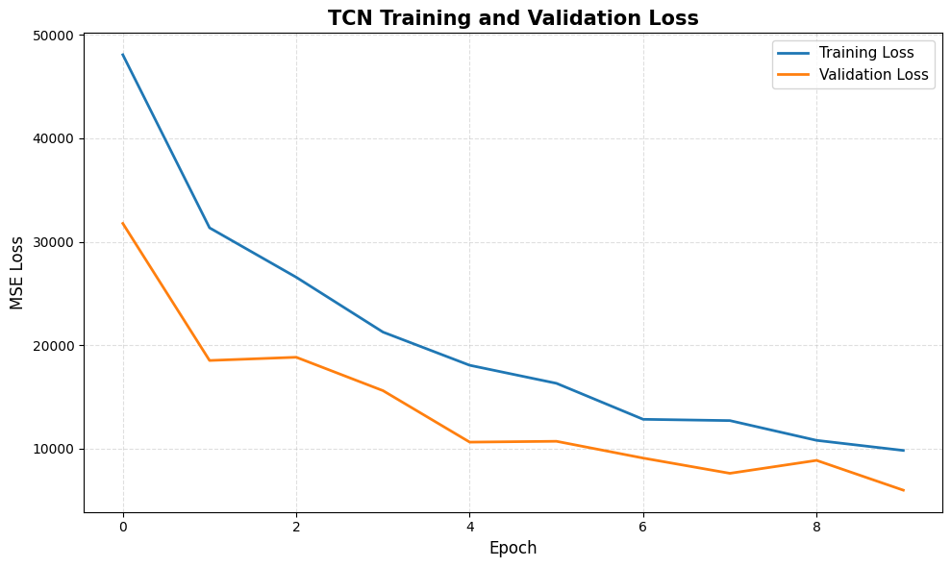
Temporal Convolutional Network (TCN)
Inputs use weekly disease sequences.
Created cyclical encoding using week_sin & week_cos.
TCN captures temporal infection patterns.
Training and Validation loss curves decreased prediction error overtime.
Results: MAE 0.548, RMSE 0.7136, R² 0.740.

Slide 11
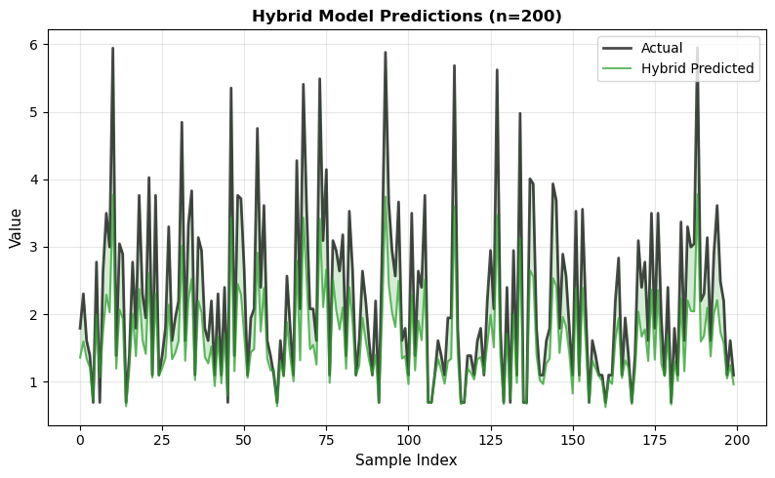
Hybrid TCN–Spatial–GBN Model
Inputs use 52-week disease sequences.
Spatial lags add nearby county influence.
TCN learns long-term disease trends.
GBN branch models factor uncertainty.
Results: MAE 0.612, RMSE 0.8301, R² 0.591.

Slide 12
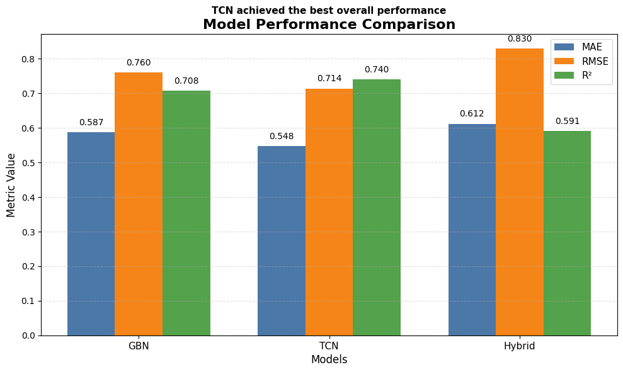
Model Performance Comparison
TCN achieved best overall performance.
TCN had lowest MAE and RMSE.
TCN had highest R² score.
GBN was strong and interpretable.
Hybrid needs additional tuning.

Slide 13
Key Findings and Manufacturing Relevance
Disease type, location and past infection spread were strongly influenced activity.
Past infection values improved future prediction.
TCN learned weekly disease trends best.
Predictions support early medicine demand planning.
County trends help regional supply decisions.

Slide 14
CONCLUSION
A complete disease prediction pipeline was developed from raw data to final model comparison.
CDC disease records were combined with Census population and BEA income data.
The project compared Bayesian, temporal, and hybrid modeling approaches.
TCN achieved the best performance by learning weekly disease patterns.
The final model supports earlier drug demand and manufacturing planning.

Slide 15
THANK YOU

